Slide 1
Week 7: Multiresolution Image Analysis
Hazal Mogultay and Fatoş T. Yarman Vural

Slide 2
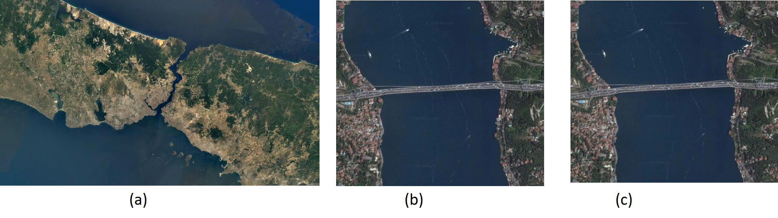
What if we need to detect sea, forest, rural areas, highways, bridges, cars, buildings, boats etc.?

Slide 3
Multiresolution Analysis
Wavelets transforms
Image pyramids and trees
Sub-band coding

Slide 4
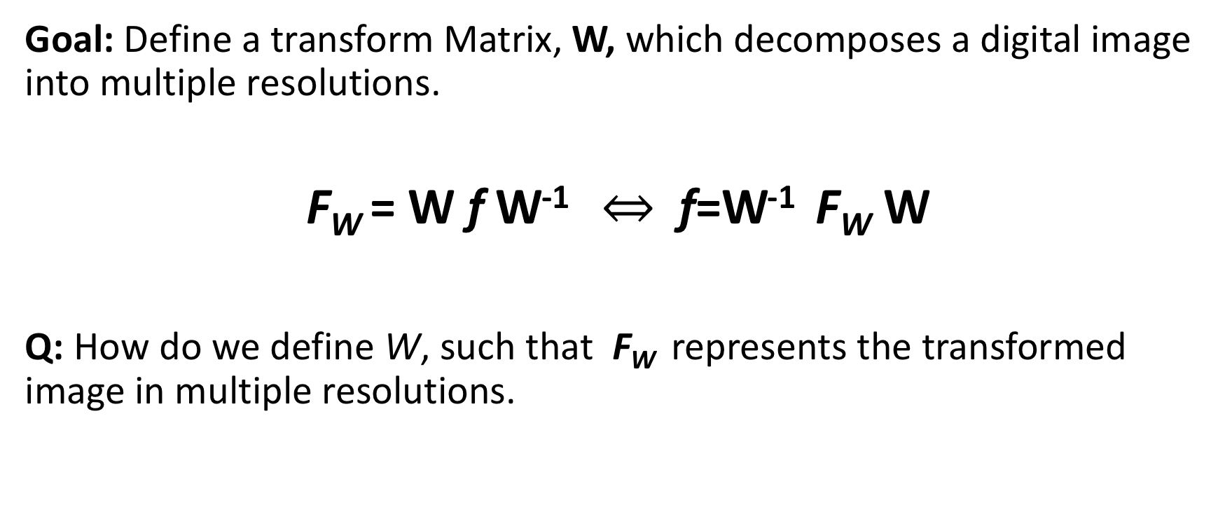
1. Wavelet Transforms

Slide 5
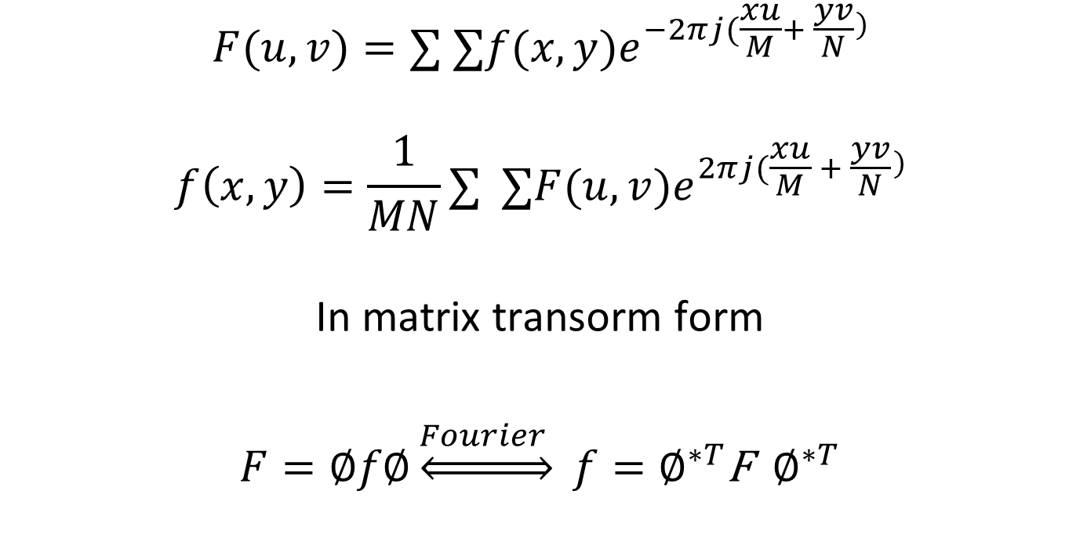
Recall Fourier Transform for Discrete Functions
$$F(u,v)=∑ ∑​f(x,y)e^{−2πj(\frac{xu}{M}+ \frac{yv}{N}})$$
$$f\left(x,y\right)=\frac{1}{MN}∑ ∑​F(u,v)e^{2πj(\frac{xu}{M} + \frac{yv}{N}})$$
In matrix transorm form
$F=∅f∅\underset{⇔}{Fourier } f=∅^{∗T}$F $∅^{∗T}$

Slide 6
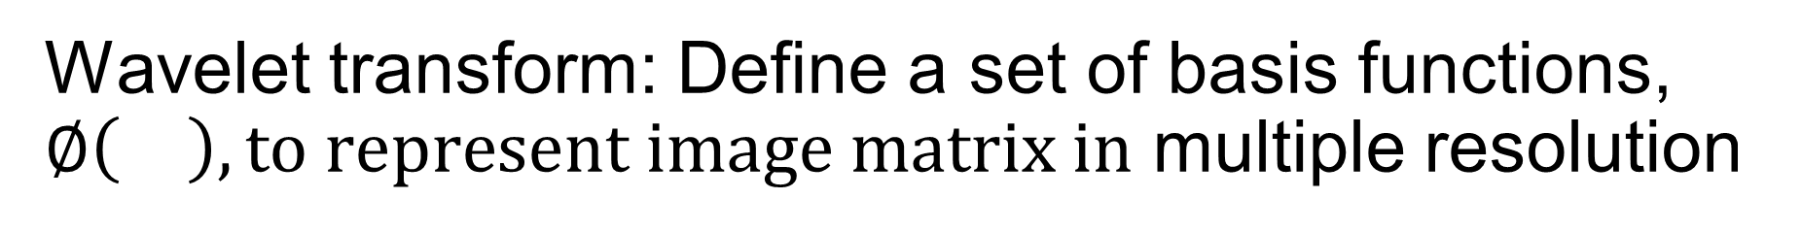
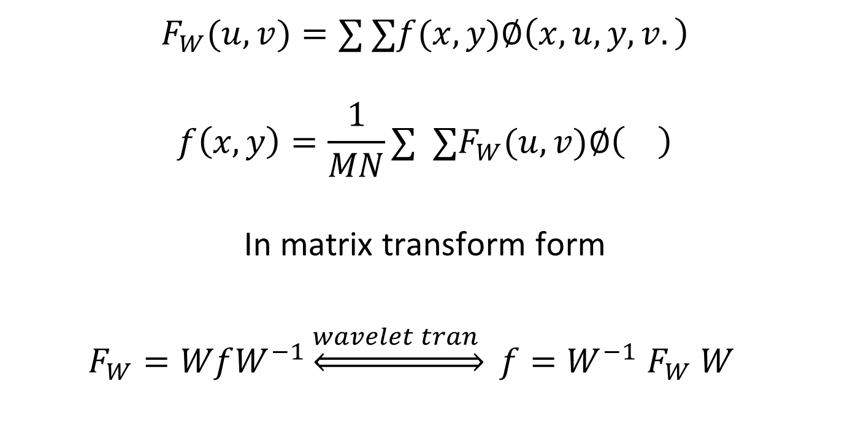
Wavelet transform: Define a set of basis functions, $∅\left(\right), to represent image matrix in$ multiple resolution
$$F_{W}(u,v)=∑ ∑​f(x,y)∅\left(x,u,y,v.\right)$$
$$f\left(x,y\right)=\frac{1}{MN}∑ ∑​F_{W}(u,v)∅\left(\right)$$
In matrix transform form
$F_{W}=WfW^{−1}\underset{⇔}{wavelet tran } f=W^{−1}$ $F_{W} W^{}$

Slide 7
How to design transform matrix W ?
Recall that the columns of W are the basis of the transform domain
W has to be invertible
W is to be preferably real and orthogonal
W has to decompose an image into multiple scale
Wavelets

Slide 8
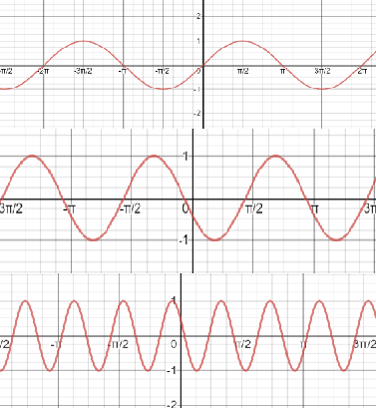
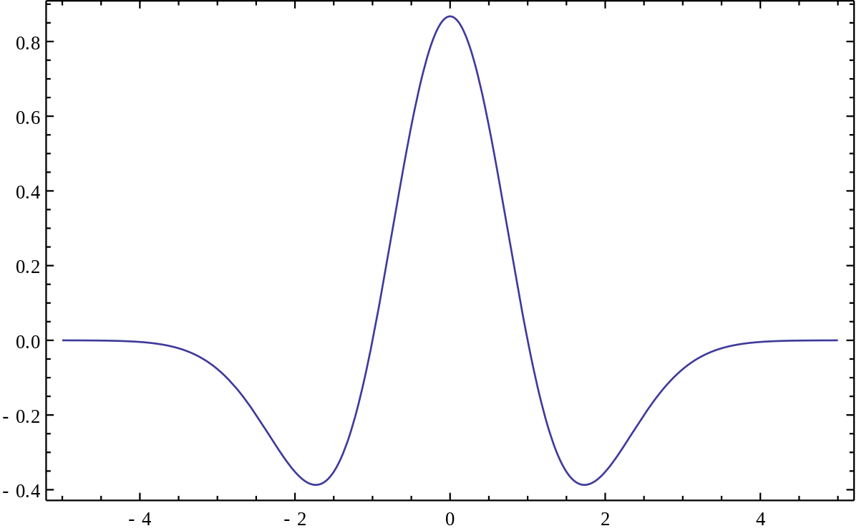
What is Wavelet? One dimensional case
A Wavelet: Finite durations
Waves: infinite duration

Slide 9

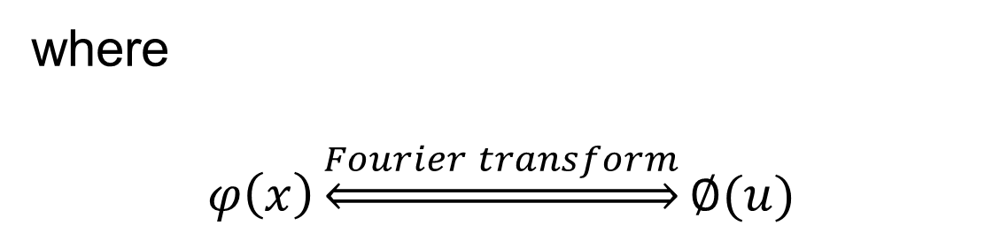
Definition (1D Case): Basic Wavelet is any real and admissible function with finite duration
Admissible
where
$$φ\left(x\right)\underset{⇔}{Fourier transform}∅(u)$$

Slide 10
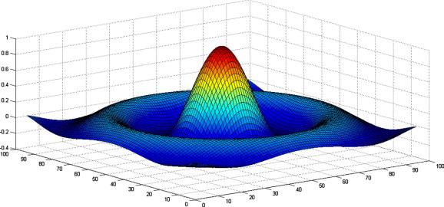

Example: Mexican hat basic wavelet function

Slide 11
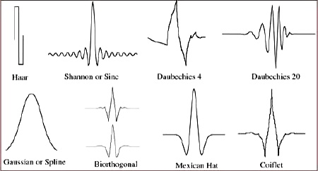
Some Basic Wavelet Functions

Slide 12
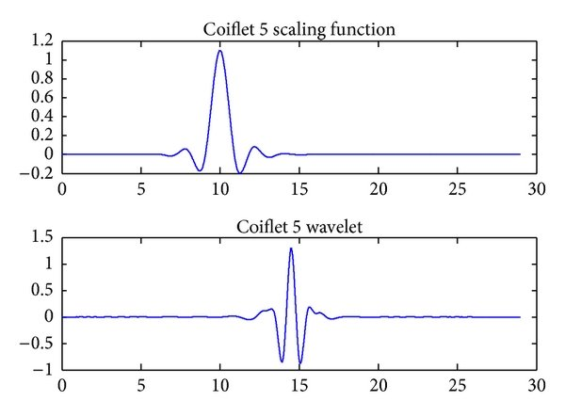
How to form a set of basis functions from a basic wavelet (1-D)?
Basic Wavelet
Squish and shift

Slide 13
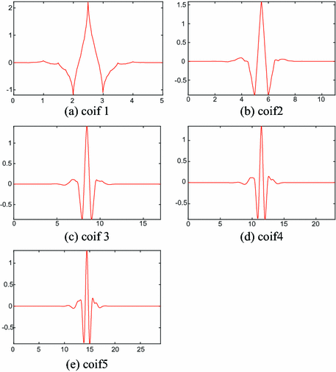
Scale and translate many times (1-D)

Slide 14
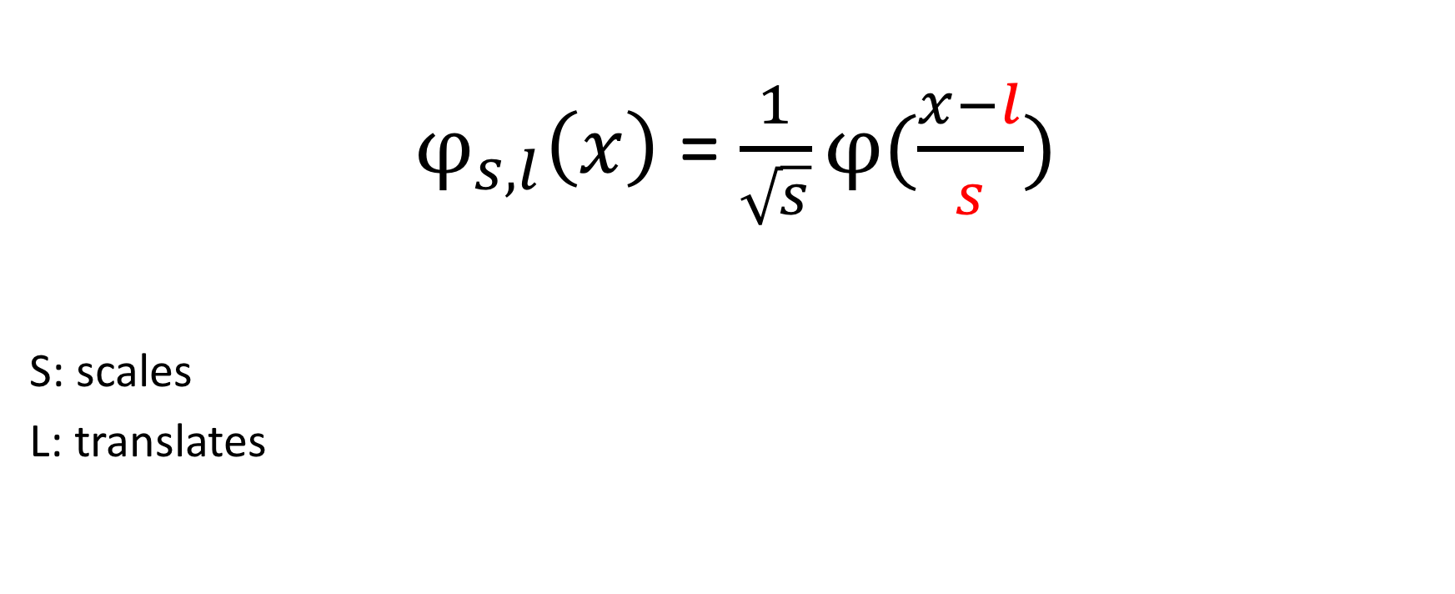
Generation of One Dimensional Basis Functions from a Basic Function

Slide 15
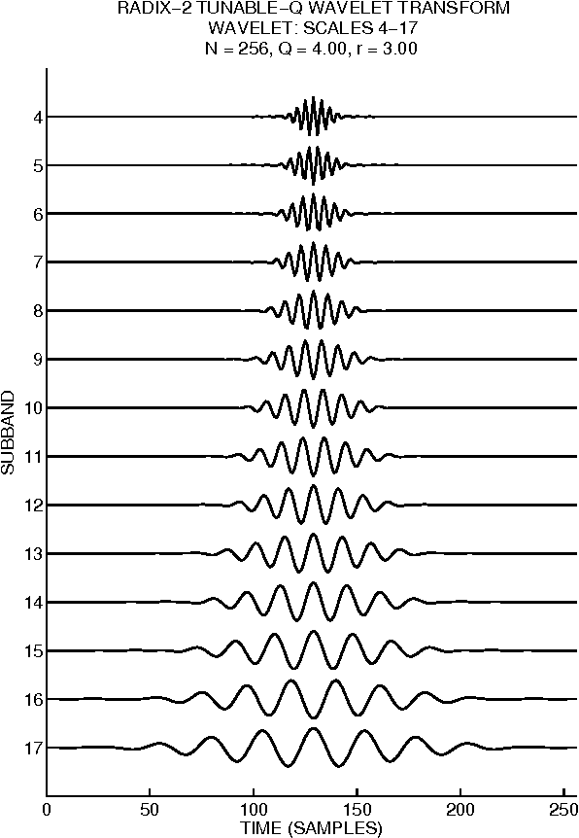
Morlet Basis Functions obtained by scaling

Slide 16
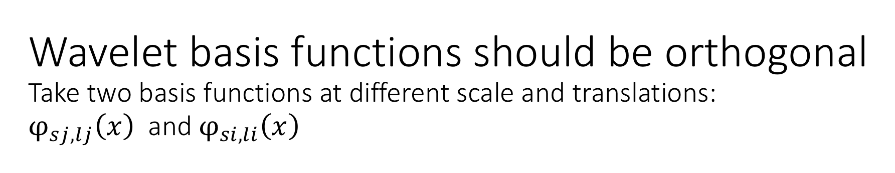
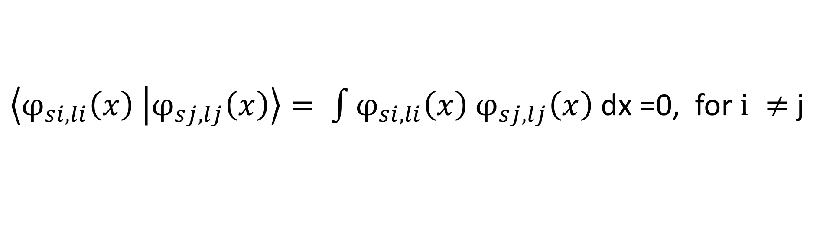

Slide 17
Recall, 1-D Continuous Fourier Transform
F(u ) ≜ ∫ f(x )exp^{−2πjux} dx,
f(x ) = ∫​ F(u ) exp^{2πjux} du

Slide 18
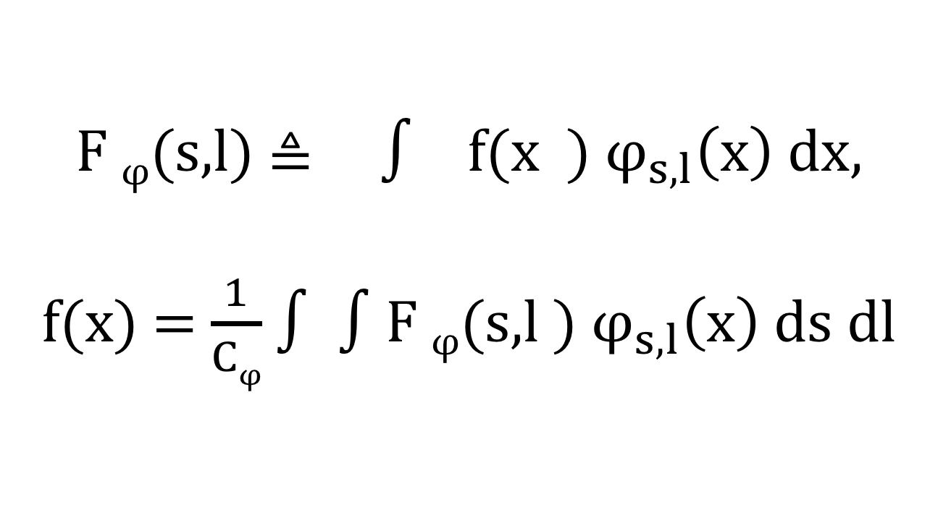
Replace Fourier Basis by Wavelet basis: 1-D continuous wavelet transform

Slide 19
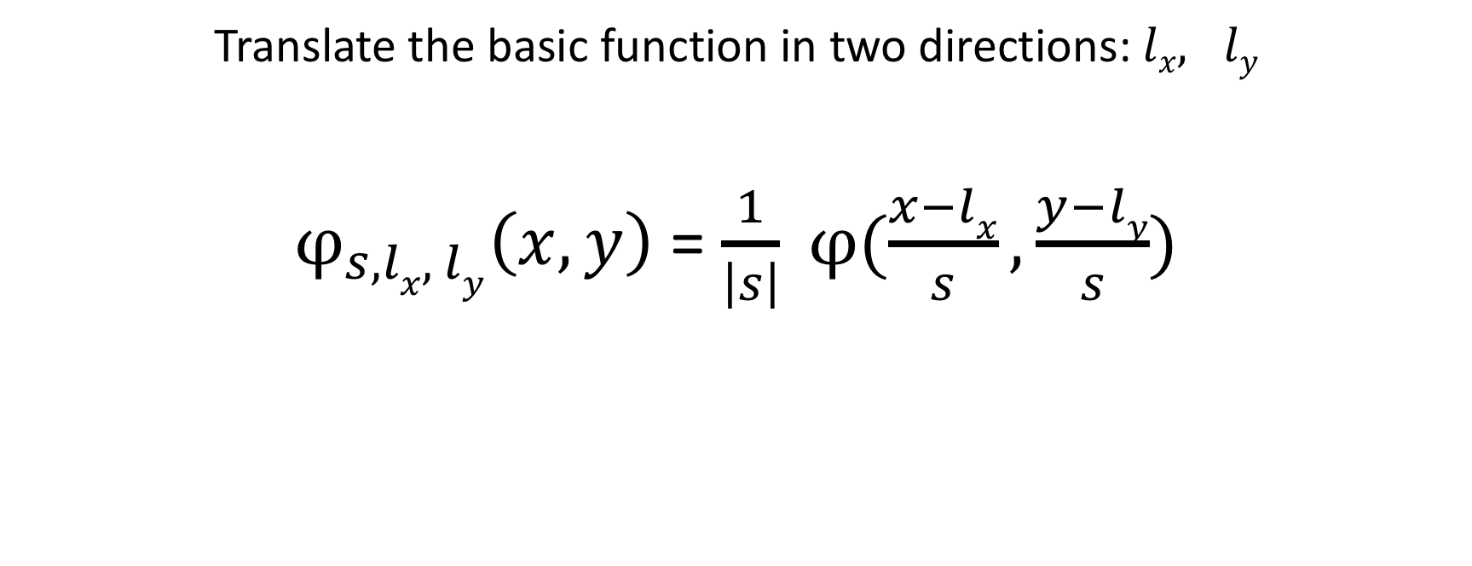
Two Dimensional Continuous Wavelet Basis Function

Slide 20
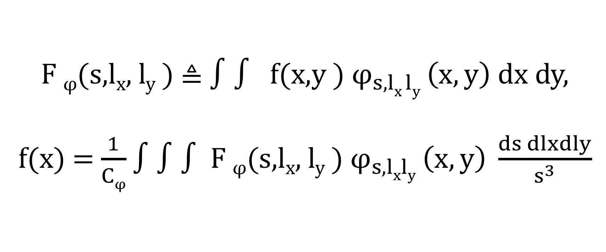
Two dimensional continuous wavelet transform

Slide 21

The normalization factor, $C_{φ}$
Admissible

Slide 22
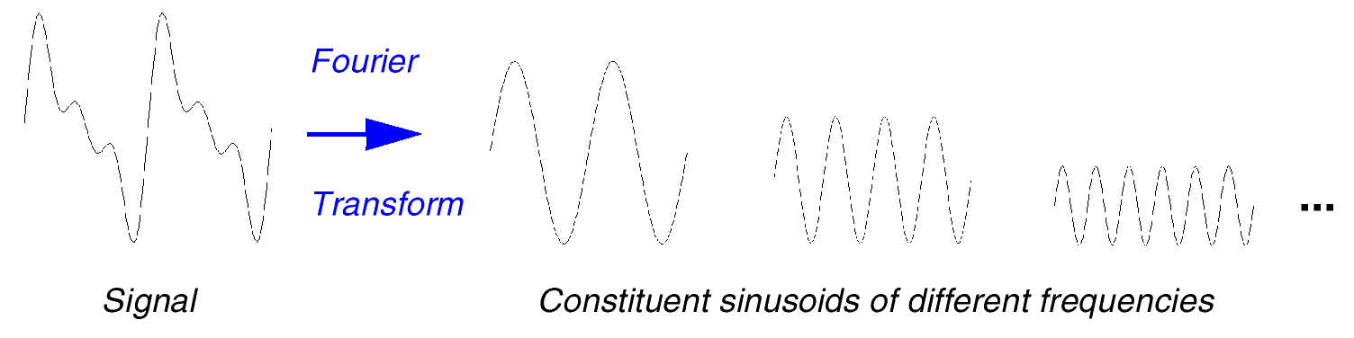
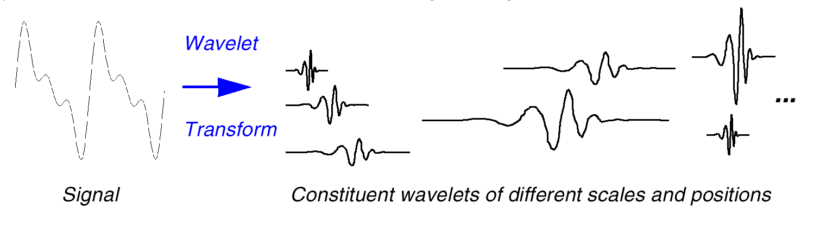
FT vs WT
weighted by F(u)
weighted by C(τ,s)

Slide 23
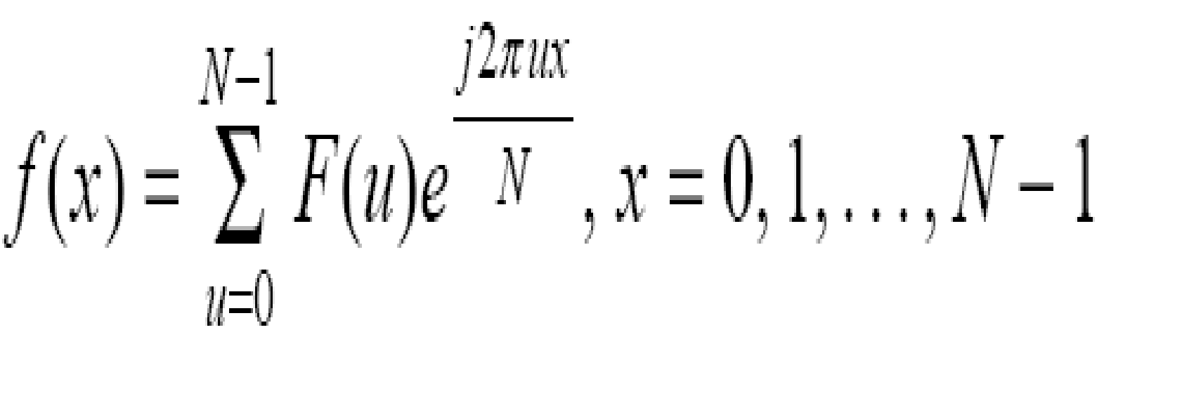
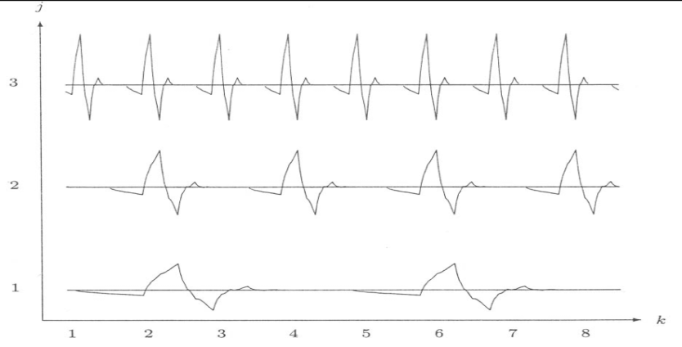

DFT vs DWT
one parameter basis
Fourier
Wavelet
two parameter basis

Slide 24
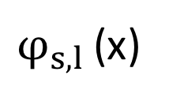
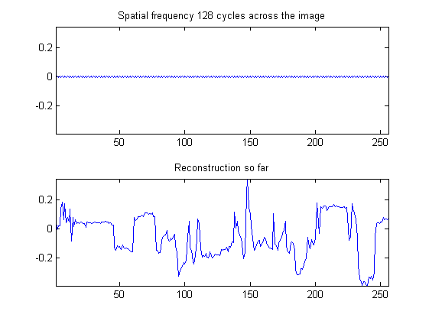
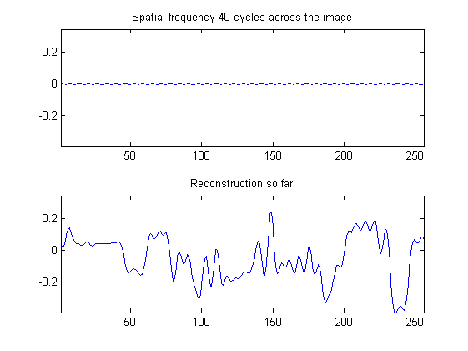
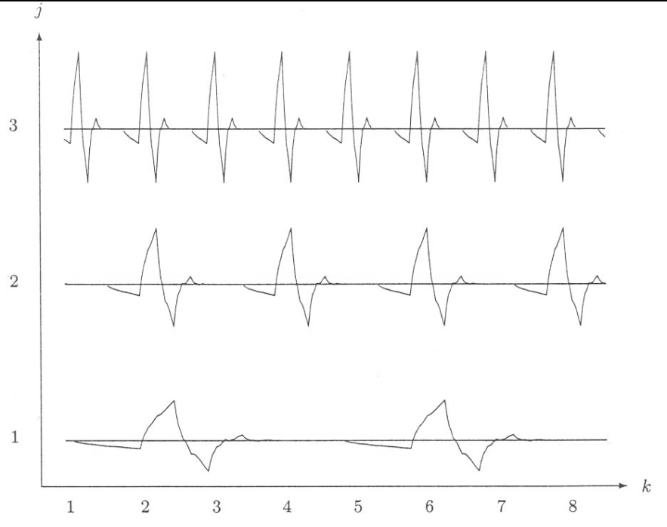

Multiresolution Representation
f(x)
fine
details
narrower, small translations
j
coarse
details

Slide 25
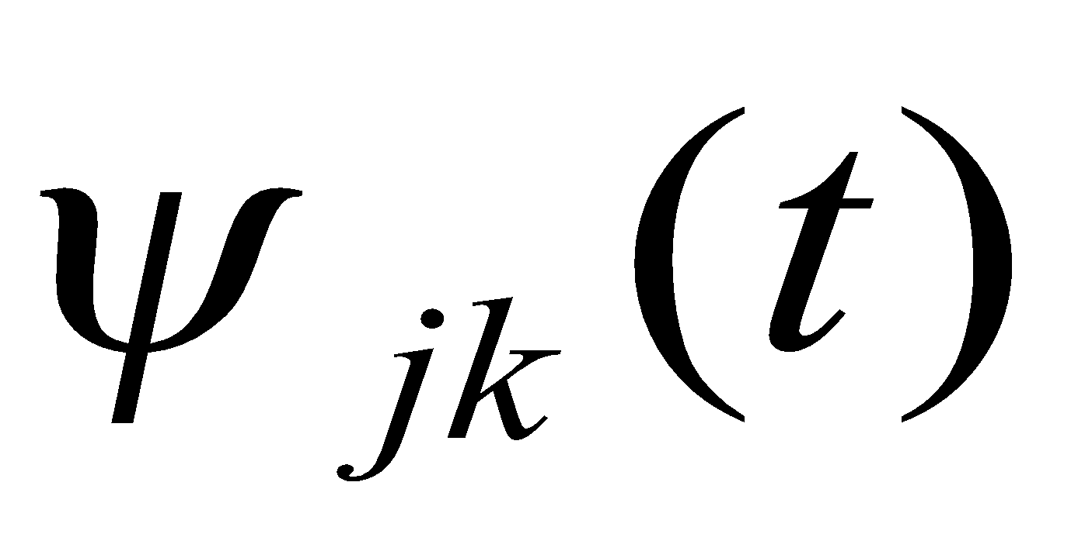
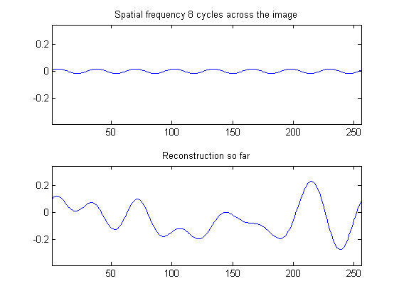
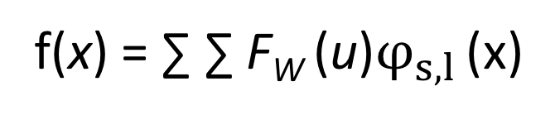
Multiresolution Representation using
f(x)
fine
details
j
coarse
details

Slide 26
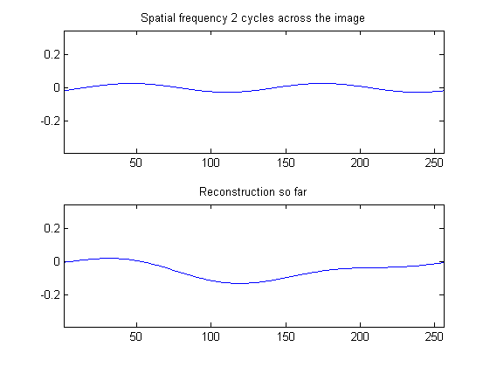
Multiresolution Representation using wavelets
f(x)
fine
details
wider, large translations
j
coarse
details

Slide 27
Multiresolution Representation using
f(x)
high resolution
_{(more details)}
f1(x)
j
f2(x)
…
f3(x)
low resolution
_{(less details)}

Slide 28
How to Scale and Shift?

Slide 29
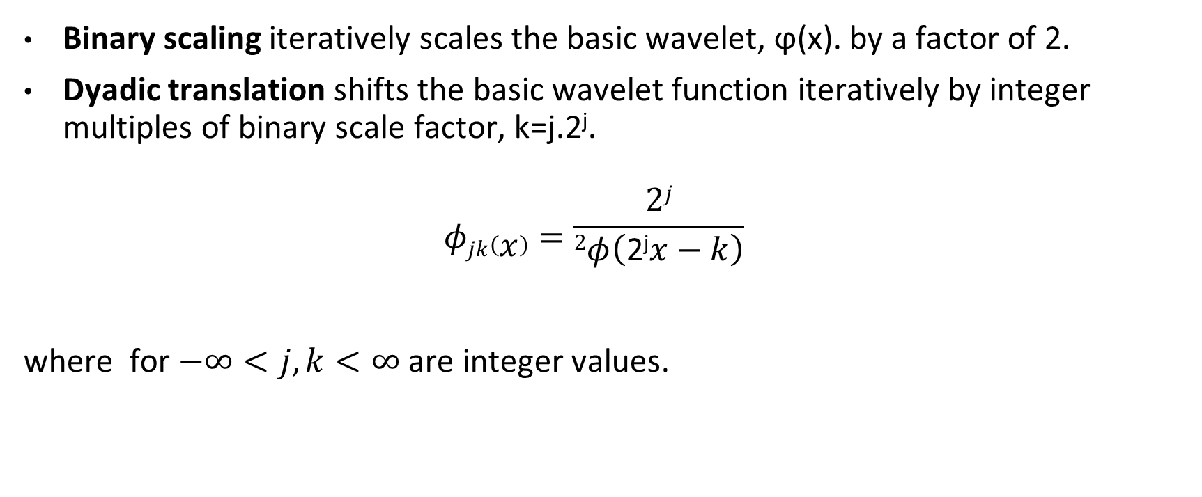
Dyadic Wavelets as a Set of Basis Functions
Binary scaling iteratively scales the basic wavelet, ϕ(x). by a factor of 2.
Dyadic translation shifts the basic wavelet function iteratively by integer multiples of binary scale factor, k=j.2^{j}.
$$φjk\left(x\right)=\frac{2j}{2φ\left(\text{2}\text{j}x−k\right)}$$
where for $−∞<j,k<∞$ are integer values.

Slide 30
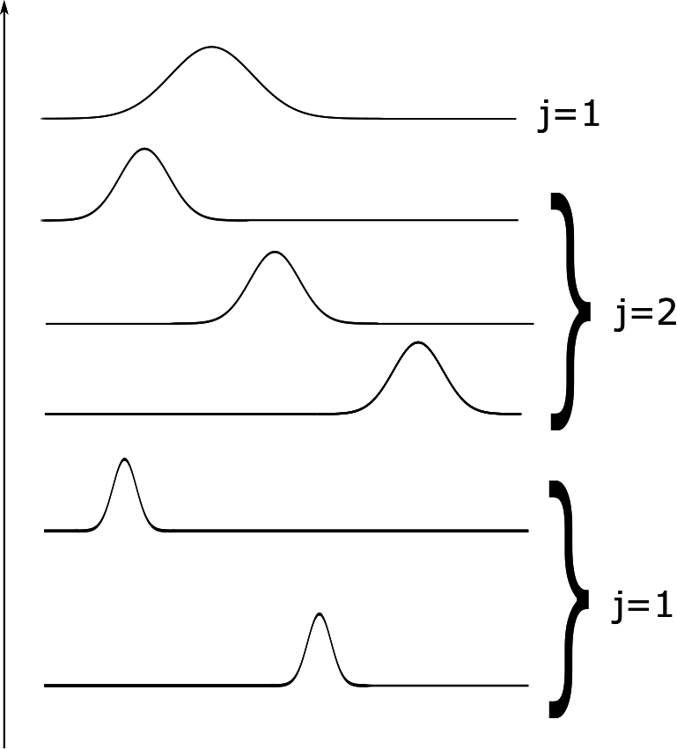
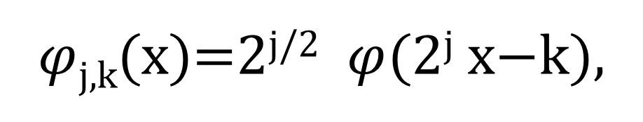
Dyadic wavelets
$φ$_{j,k}​(x)=2^{j​/2} $φ$(2^{j​} x−k),

Slide 31
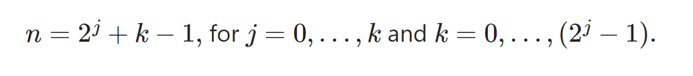
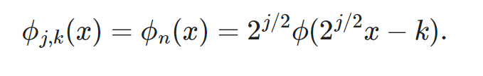
Compact dyadic wavelets: Get rid of two indeces, j,k
n | 0 | 1 | 2 | 3 | …
j | 0 | 0 | 1 | 1 | …
k | 0 | 1 | 1 | 2 | …

Slide 32
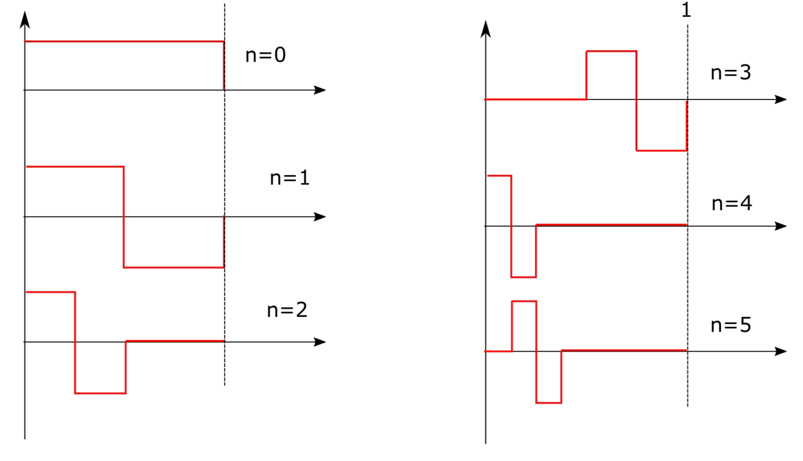
A Compact Dyadic Wavelet Basis Functions One Dimensional Haar Function

Slide 33
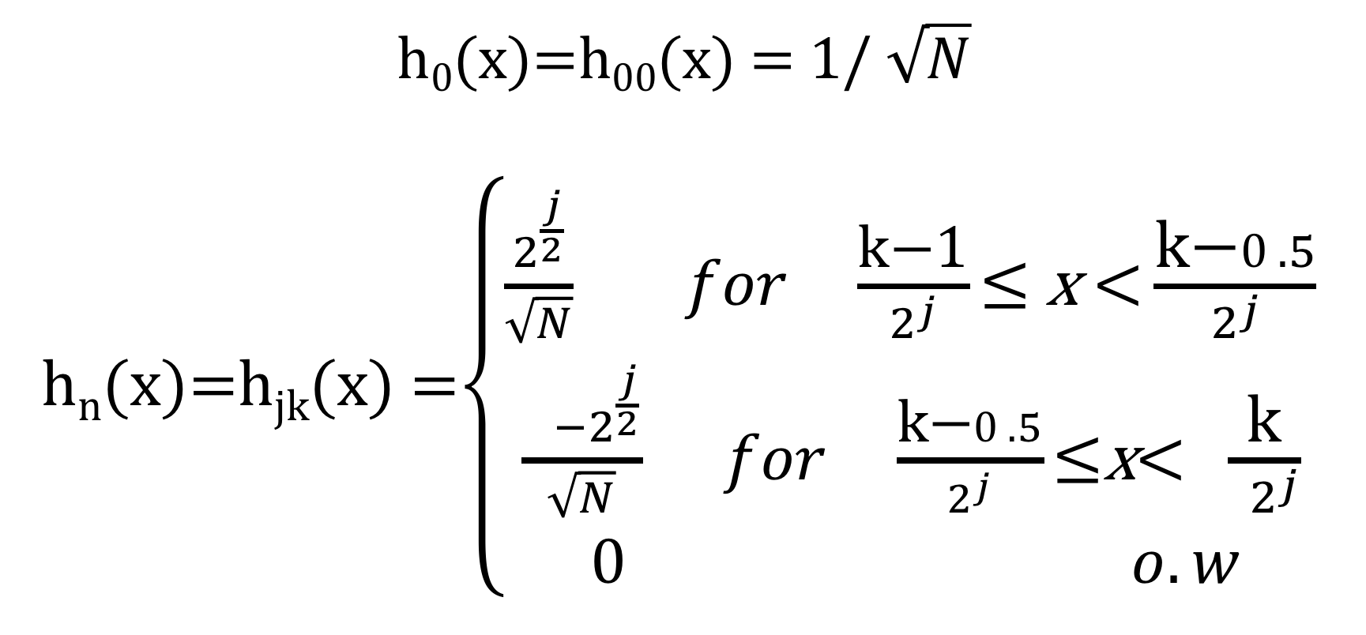
Haar Functions: Compact Dyadic Wavelet Basis Functions

Slide 34
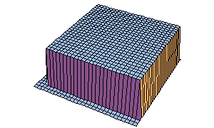
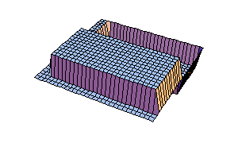
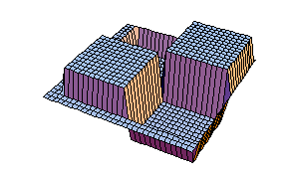
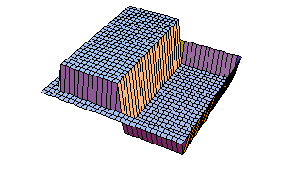
Two Dimensional Haar Basis Functions
2D Haar Basis wavelets:

Slide 35
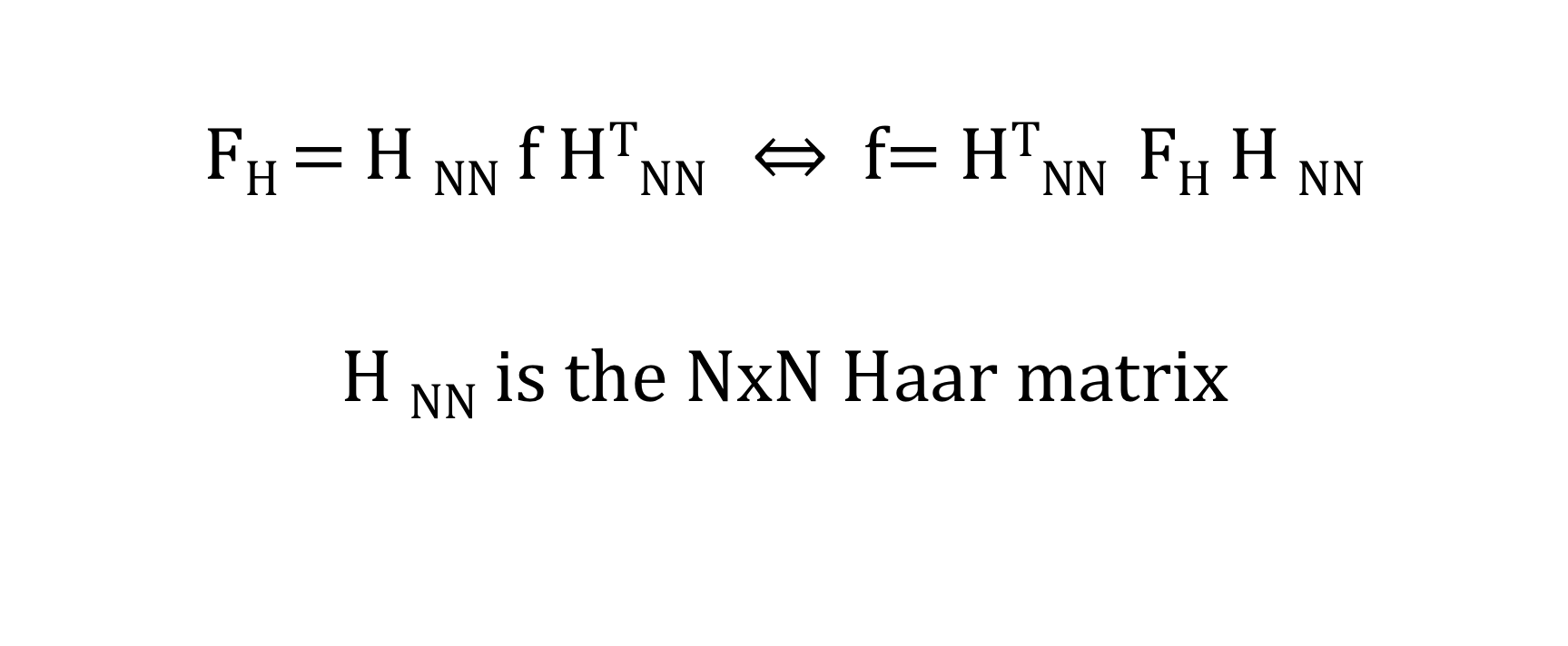
Two-Dimensional Discrete Haar Transform

Slide 36

Normalize and Sample x of h_{n}(x) = h_{jk}(x) :
x=(0/N)​, (1/N)​,…, (N−1/N)​.
For each scale index n, we obtain a vector of N dimension
h_{n} = [h_{n} (0), h_{n}(1/N), ……., h_{n}(N-1/N)]

Slide 37
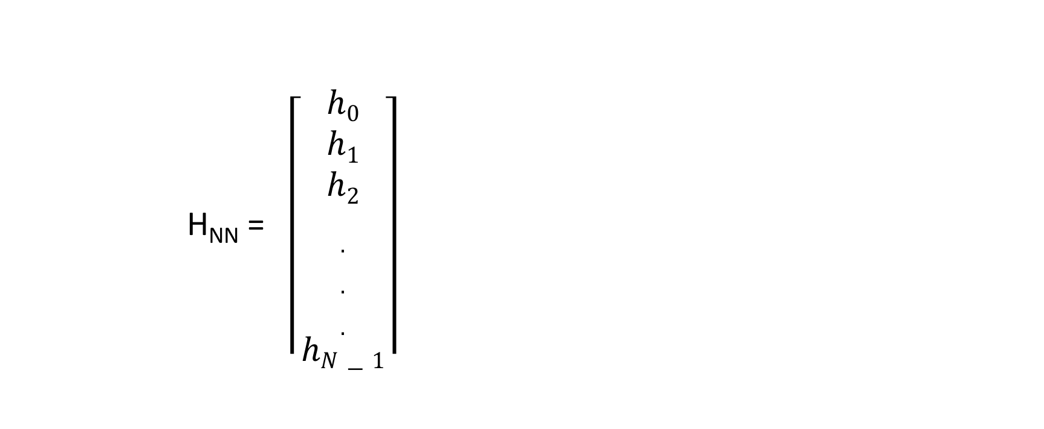
Haar matrix of NxN dimension

Slide 38
Ex: Find 2x2 Haar Matrix
Find 2x2 Haar Matrix

Slide 39
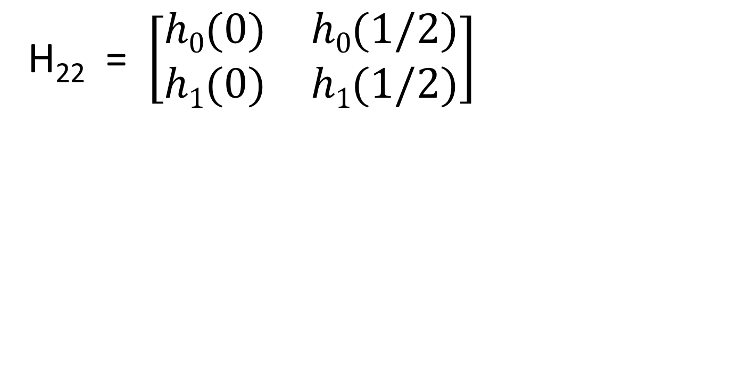
2x2 Haar Matrix

Slide 40
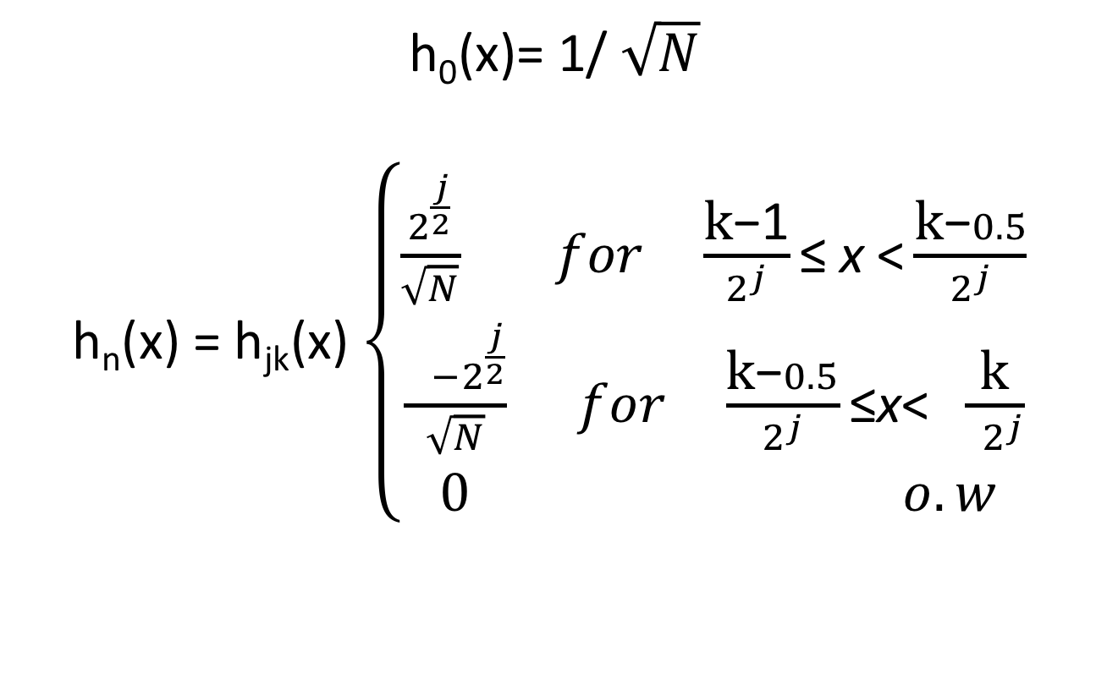
Recall that
n | 0 | 1 | 2 | 3 | …
j | 0 | 0 | 1 | 1 | …
k | 0 | 1 | 1 | 2 | …

Slide 41
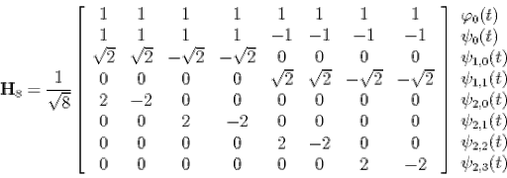

Slide 42
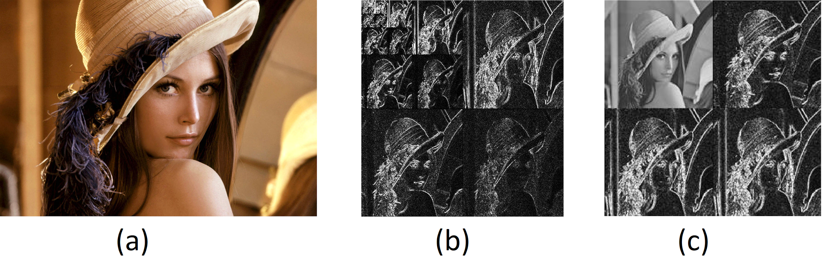
Haar Transform of Lena Image

Slide 43
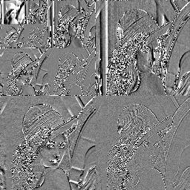
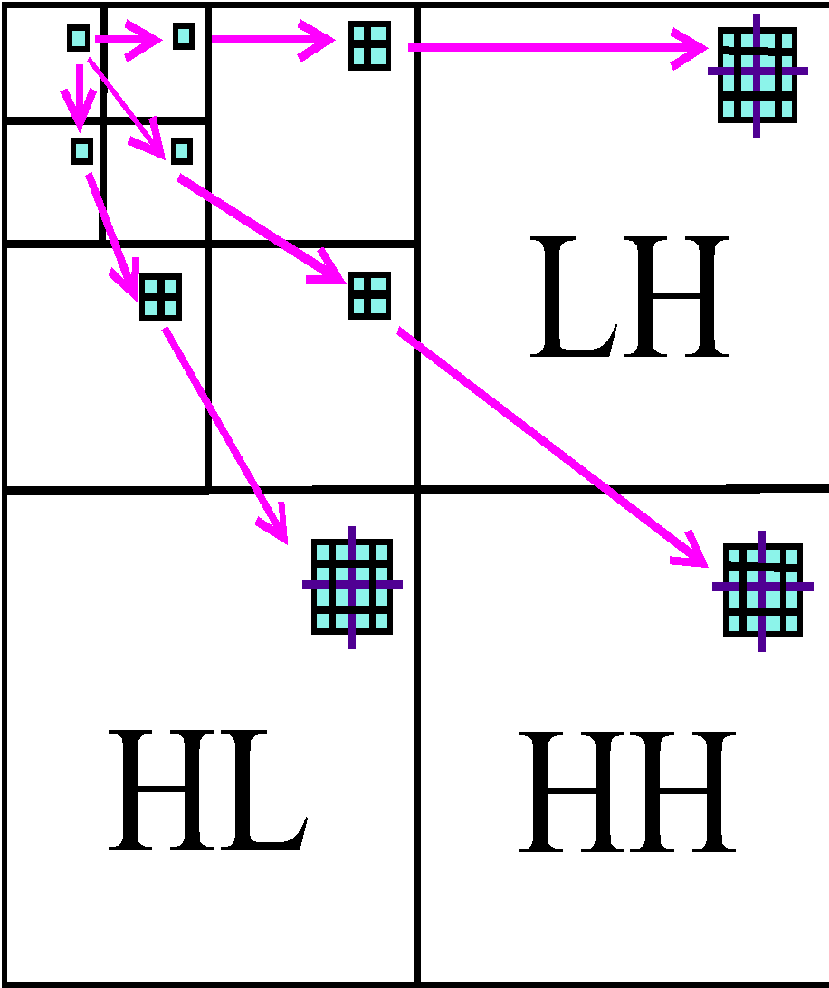
Wavelet Decomposition:Example
LENA

Slide 44

Two Dimensional Extension of Wavelet Transform for Discrete Functions

Slide 45
Multiresolution Analysis
Wavelets transforms
Image pyramids and trees
Sub-band coding

Slide 46


2. Image Pyramids
Given N×N image matrix, f, where, N=2^{J}, generate stack of images:
At level j: Resolution
$( fj​ )= ½ ​Resolution (fj+1​ ) , j=0,…,(J−1)$
Q: How to replace the color of 4 pixels by a single color?

Slide 47

Use some approximation filter

Slide 48
Storage Space
Storing a pyramid, consisting of images of multiple resolutions is expensive compared to that of Wavelet transform.
O(N²(1+1/4+1/16+…)) = O(1.33N²).

Slide 49

Image Trees: T={P_{k}​ , R(k,i,j)}
The set of nodes at level k:
P_{k}​={p=(k,i,j), k=(0, (J−1)) , (i,j)∈[0,2^{k−1}]}
Relations between the parent and children:
R(k,i,j): P_{k-1}→P_{k}

Slide 50
Generation of Image Tree
Down-sample by a predefined ratio
Quad trees
Uniformity trees

Slide 51

Quad Tree: Split image into homogenous regions hierarchicaly

Slide 52


Image compression

Slide 53


Content description

Slide 54

Uniformity Tree

Slide 55

Uniformity Tree (Pınar’s Tree)
At level J, merge all neighboring pixels with the same color.
At level j, compute the most similar colors by
D_{j} = min​ [(ri​−rj​)²+(gi​−gj​)²+(bi​−bj​) ²]
∀ij
Rule:
1. Merge neighboring region with D_{j}
2. Assign the average color to merged regions

Slide 56

Algorithm: Uniformity Tree Generation
Input: Regions, {Ri} with the same color, a color similarity measure.
At each level of the tree
For each pair of neighboring regions {Ri, Rj} compute color distance d(Ri,Rj) according to a similarity measure.
Insert d(Ri,Rj) into the distance list.
At each level, identify the minimum of two colors between the adjacent regions by computing,
$$Dj=min D \left(Ri,Rj\right),$$
4. Merge {Ri, Rj} if D(Ri,Rj)=Dj, keep otherwise.
5. Assign the color of the merged pixels as the average color.

Slide 57

Uniformity Tree Outputs
a1) original image; b1) level=16; c1) level=10; d1) level=5; and e1) level=3;

Slide 58

Levels of uniformity tree

Slide 59
3. Subband Coding
Use the power of Fourier transform to decompose image into frequency bands

Slide 60




Recall Fourier Transform

Slide 61
3. Subband Coding
Goal : Design a set of collectively exhaustive filters, called filter bank, such that each filter passes a certain frequency bandwidth and the collection of the filter bandwidths cover the entire spectral band.

Slide 62

F_{i​}(u,v)=F(u,v)⋅H_{i​}(u,v), for i=0,...,n−1
f_{i​}(x,y) → F_{i​}(u,v)

Slide 63

1-D Case: Ideal Band-pass Filter

Slide 64

1D Case: In practice: Two-Band Coding of One-Dimensional Images

Slide 65


Subband filters: $H_{0},H_{1}$, $H_{2}$…. $H_{n−1}$
Decompose image into subbands:
$f_{0} \underset{⇔}{F}$ $F_{0}$= F. $H_{0}$
$f_{1} \underset{⇔}{F}$ $F_{1}$= F. $H_{1}$
………………..
$f_{n−1} \underset{⇔}{F}$ $F_{n−1}$= F. $H_{n−1}$

Slide 66

Analysis Filter Bank: Two-band Coding of One dimensional Images

Slide 67


Synthesis Filter Bank: Two-Band Decoding One Dimensional İmages
$$g0​\left(x\right)=\left(−1\right)x h1​(x) \\ g_{1\left(x\right)}= \left(−1\right)x h0(x)$$

Slide 68

2-Band Coding for 2-D Functions

Slide 69


Output of two band coding in 2-D Images

